Slide 1


Dynamical compensation in physiological circuits & Endocrine Autoimmune Disease as a Fragility of Immune Surveillance against Hypersecreting Mutants
Zhang Muyuan
August 13, 2025
Journal Club

Slide 2



Paper Snapshot

Slide 3
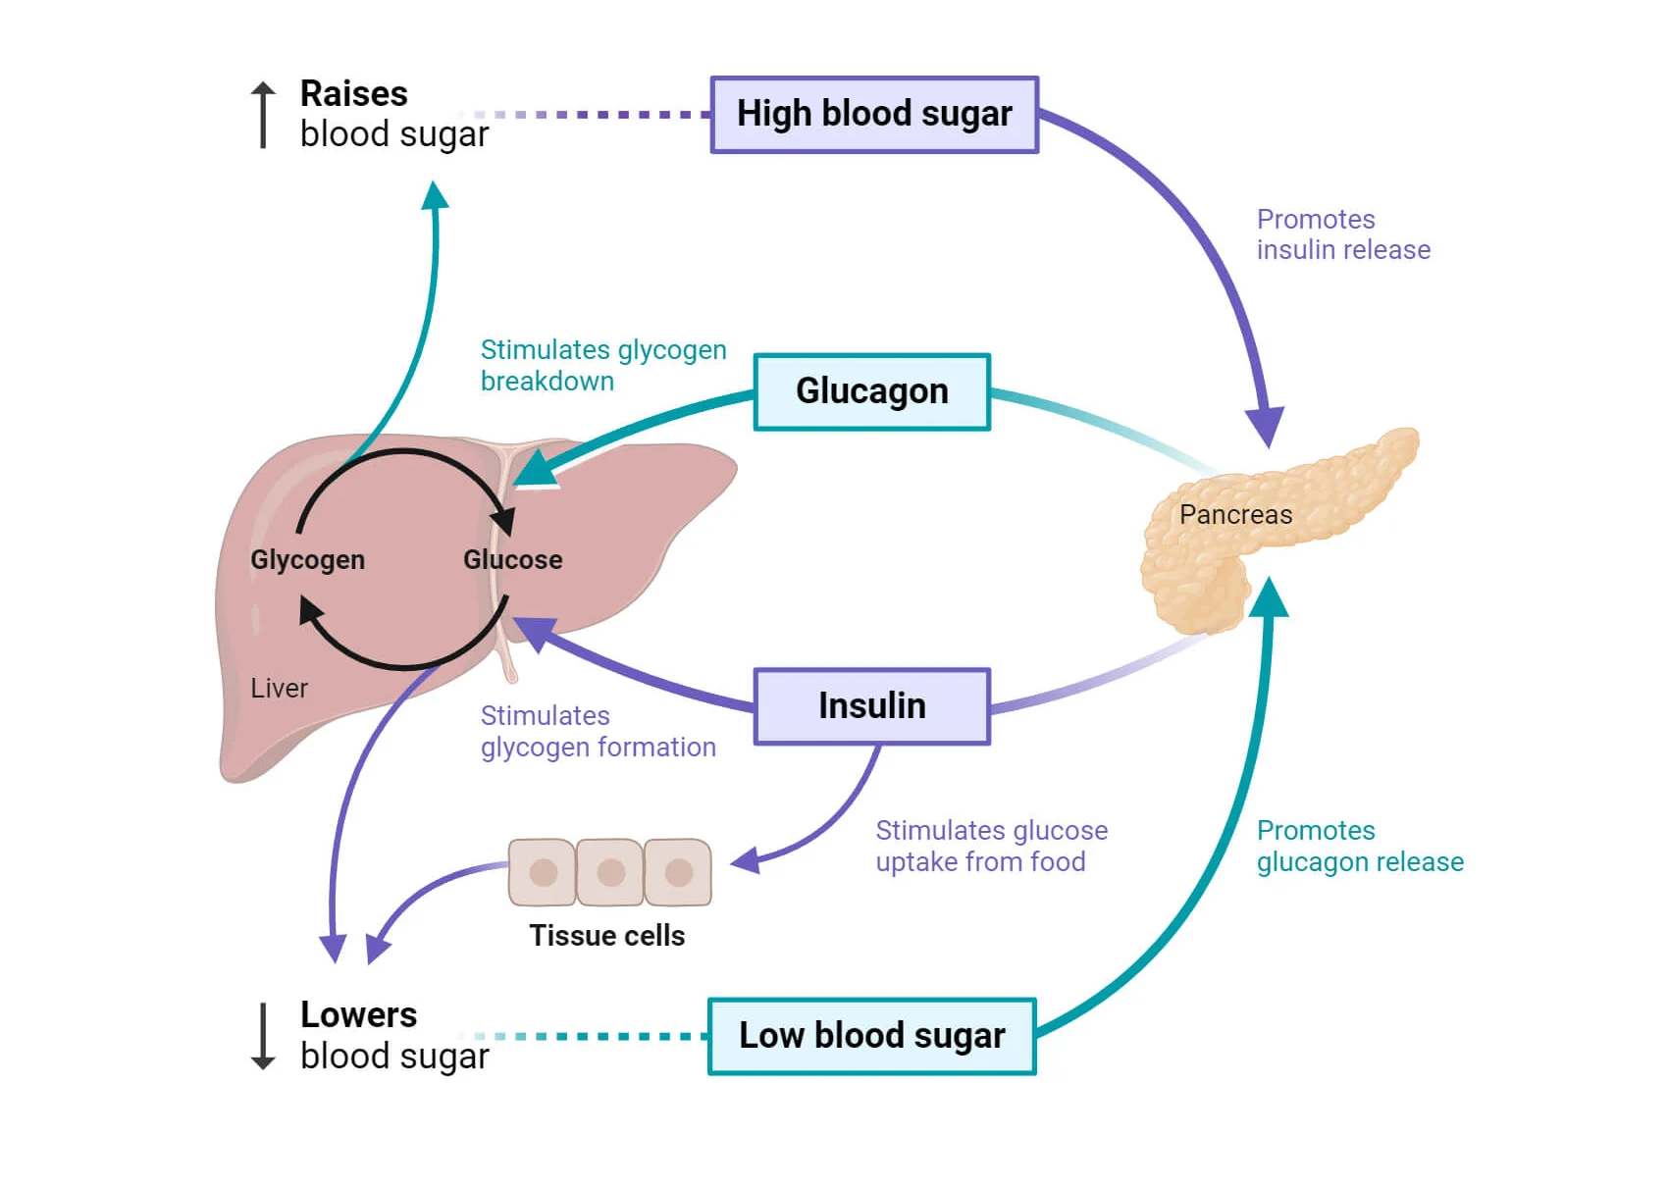
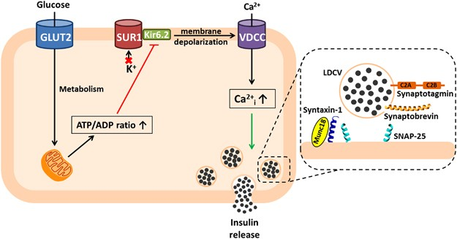
Background | glucose homeostasis
Insulin-like growth factor I (IGF-I) stimulated pancreatic beta-cell growth is glucose-dependent.
Hügl SR, White MF, Rhodes CJ (1998)

Slide 4
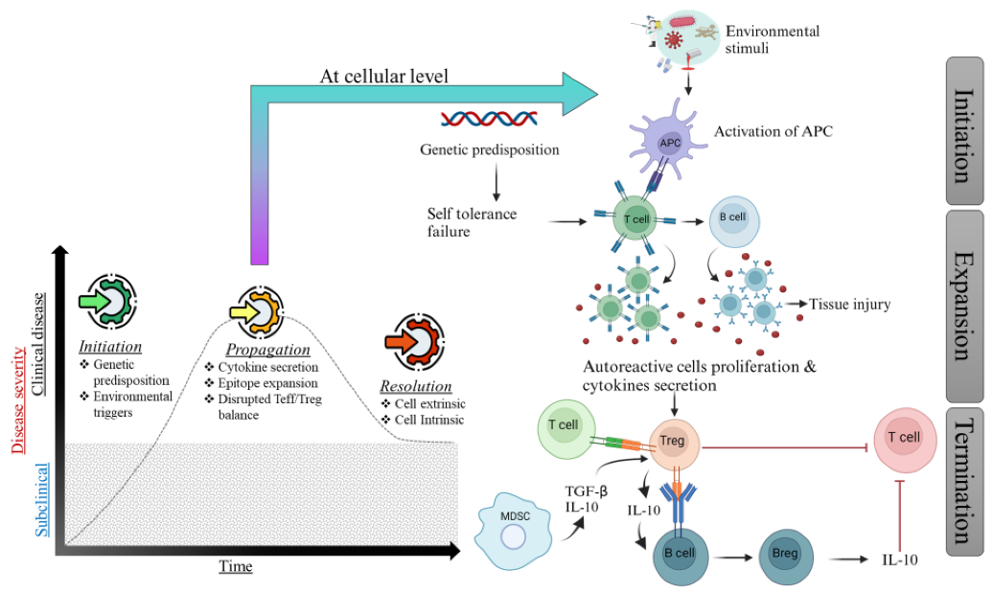
Background | autoimmune diseases

Slide 5
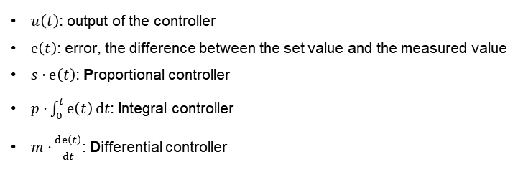
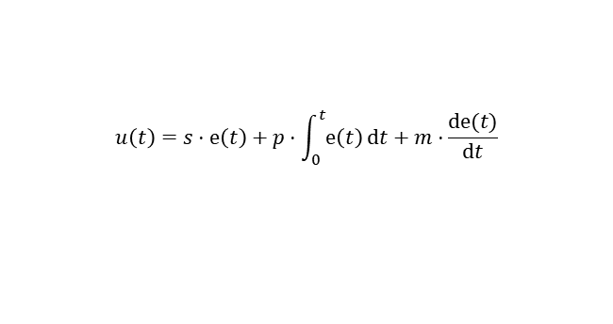
Background | integral feedback
$$u\left(t\right)=s⋅ⅇ\left(t\right)+p⋅\int_{0}^{t}{ⅇ\left(t\right)ⅆt}+m⋅\frac{ⅆⅇ(t)}{ⅆt}$$
$u\left(t\right)$: output of the controller
$ⅇ\left(t\right)$: error, the difference between the set value and the measured value
$s⋅ⅇ\left(t\right)$: Proportional controller
$p⋅\int_{0}^{t}{ⅇ\left(t\right)ⅆt}$: Integral controller
$m⋅\frac{ⅆⅇ\left(t\right)}{ⅆt}$: Differential controller

Slide 6
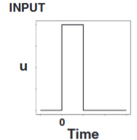
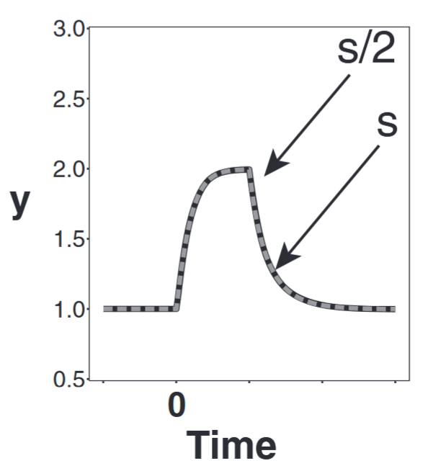
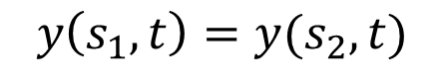
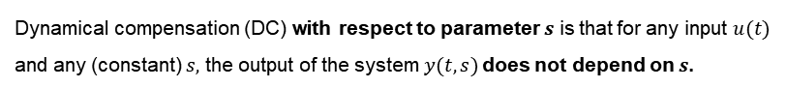
Dynamic compensation is a novelly discovered type of motif feature that ensures precise dynamics.
Dynamical compensation (DC) with respect to parameter $s$ is that for any input $u(t)$ and any (constant) $s,$ the output of the system $y(t,s)$does not depend on $s$.
$$y\left(s_{1},t\right)=y(s_{2},t)$$
Adaption is good but not enough.
Deviations from a precise dynamic response can cause disease.

Slide 7
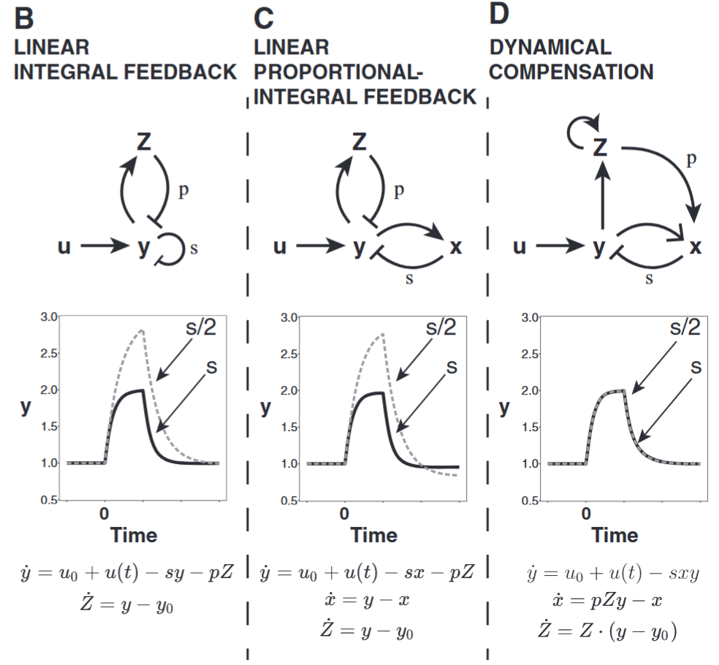
Dynamic compensation is a novelly discovered type of motif feature that ensures precise dynamics.
s: the proportional gain p: the integral gain
Dynamical compensation is different from exact adaptation, which guaranteed by (linear) integral feedback.
(Adaptation: the property of maintaining a constant set point for a regulated variable despite variation in system parameters.)
: Adaptation
: DC

Slide 8
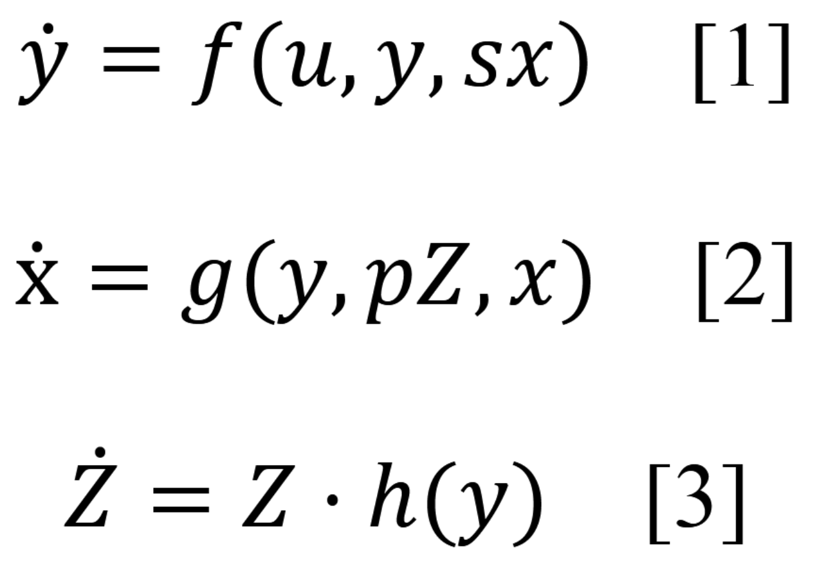
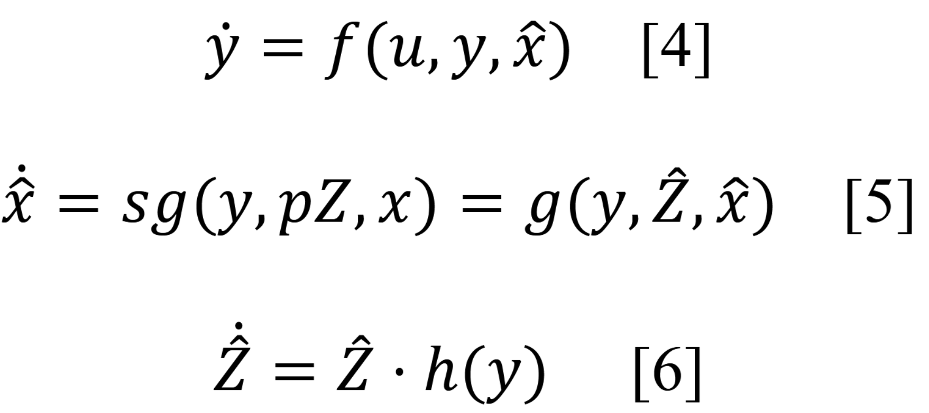

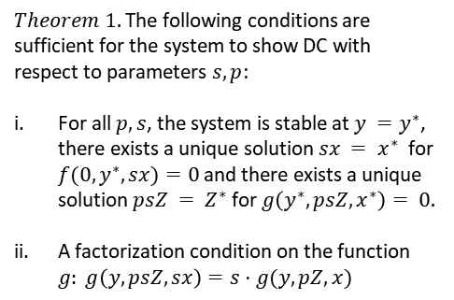
A model derived from the glucose homeostasis system shows DC.
$Theorem 1.$The following conditions are sufficient for the system to show DC with respect to parameters $s,p$:
For all $p, s$, the system is stable at $y =y^{∗}$, there exists a unique solution $sx = x^{∗}$for $f(0,y^{∗},sx)=0$and there exists a unique solution $psZ = Z^{∗}$for $g\left(y^{∗},psZ,x^{∗}\right)= 0.$
A factorization condition on the function $g: g\left(y, psZ, sx\right)=s⋅g(y, pZ, x)$
$$let: x = sx, Z = psZ$$

Slide 9
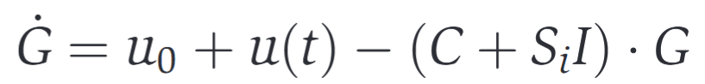
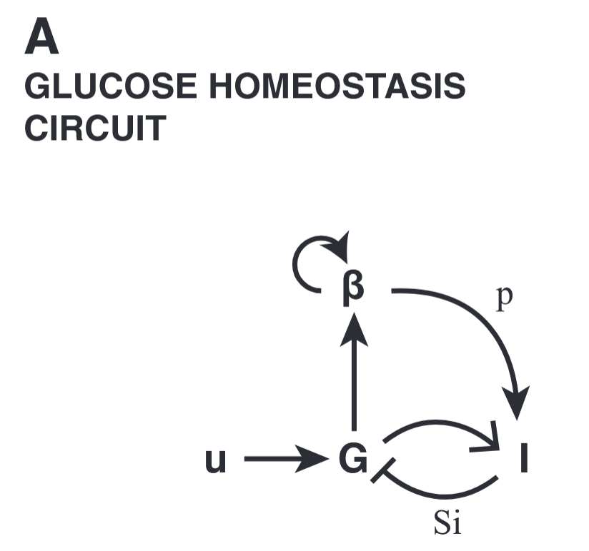
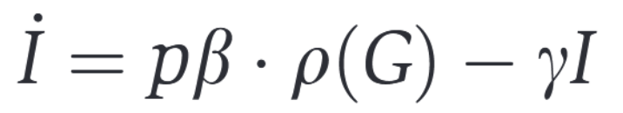
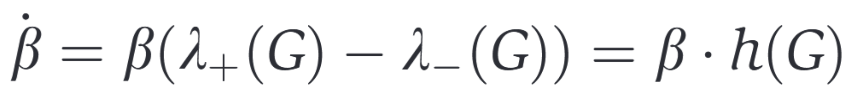
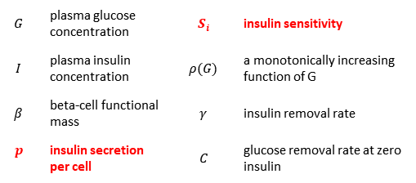

A model derived from the glucose homeostasis system shows DC.
The $βIG$ model
$$G$$ | plasma glucose concentration | $$S_{i}$$ | insulin sensitivity
$$I$$ | plasma insulin concentration | $$ρ(G)$$ | a monotonically increasing function of G
$$β$$ | beta-cell functional mass | $$γ$$ | insulin removal rate
$$p$$ | insulin secretion per cell | $$C$$ | glucose removal rate at zero insulin

Slide 10
A model derived from the glucose homeostasis system shows DC.
Key Observations:
Even mild abnormalities in either fasting glucose levels or postprandial glucose response dynamics are clinical indications of pre-diabetes with significant long-term health implications.
Insulin sensitivity (Si), can vary between individuals and throughout life by almost an order of magnitude.
There’s strong correlation between beta-cell mass and body weight during growth.

Slide 11
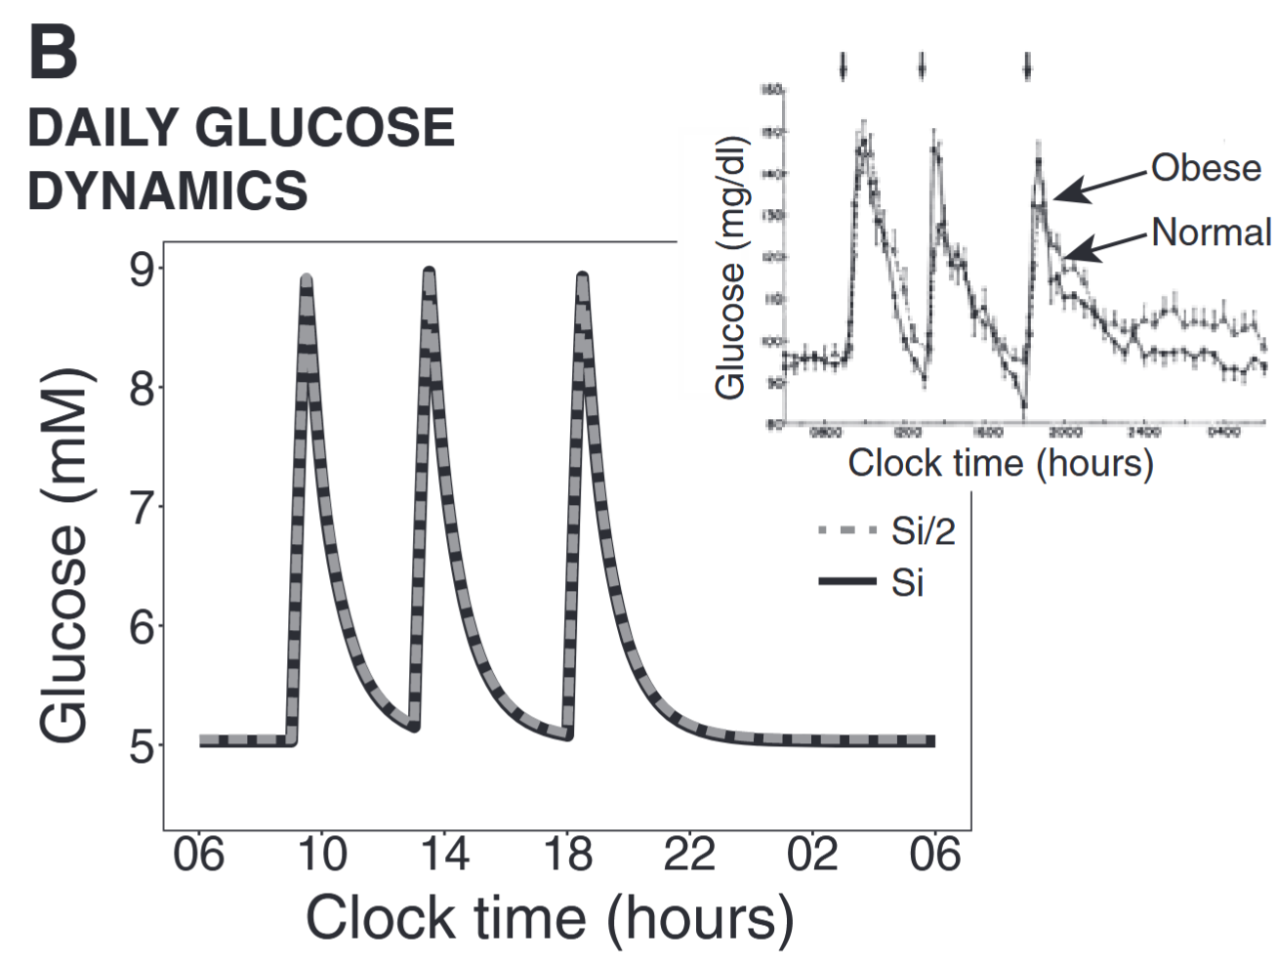
A model derived from the glucose homeostasis system shows DC.
The systems gives precisely identical response dynamics with DC to certain parameters.

Slide 12
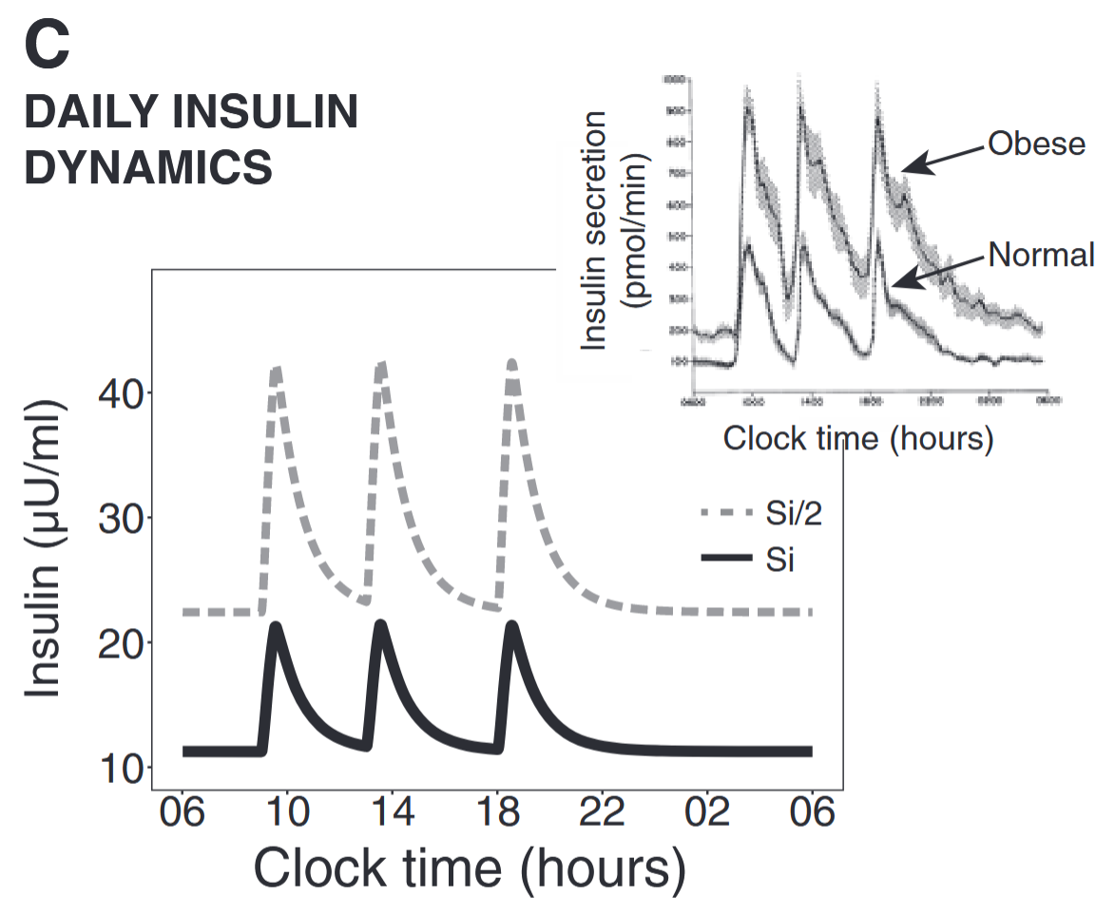
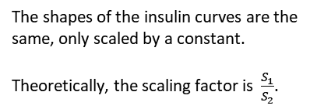

A model derived from the glucose homeostasis system shows DC.
The shapes of the insulin curves are the same, only scaled by a constant.
Theoretically, the scaling factor is $\frac{S_{1}}{S_{2}}$.
Recall: $let: x = sx, Z = psZ$

Slide 13
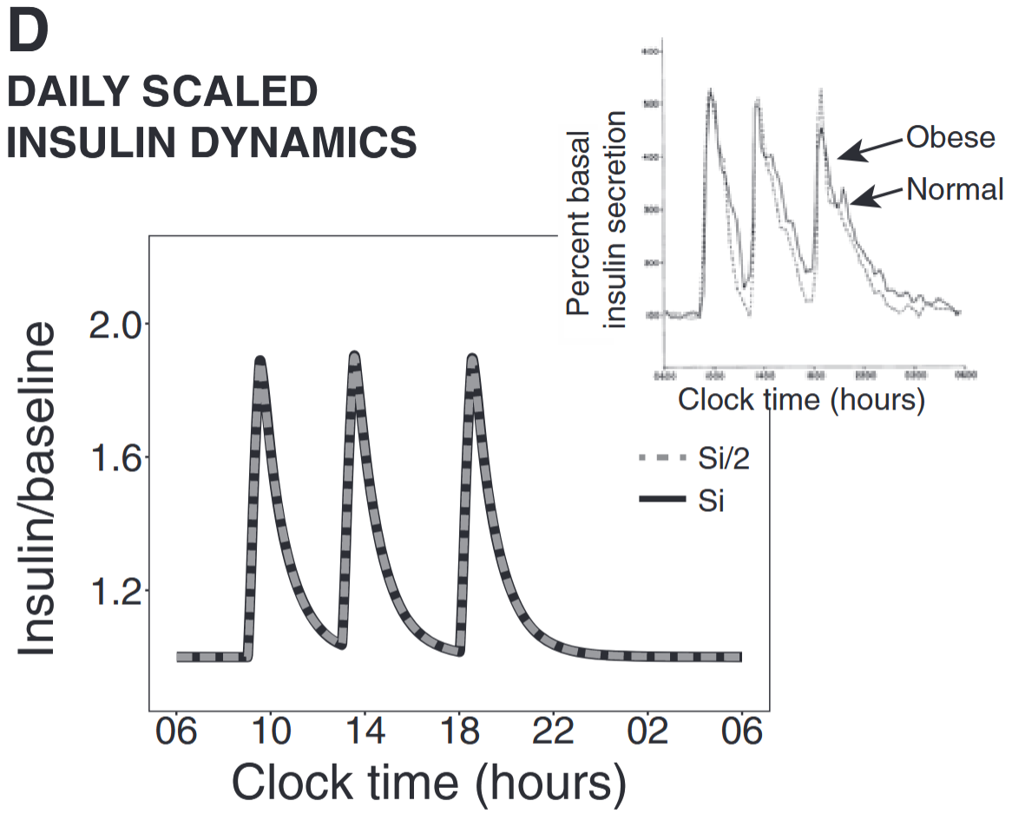
A model derived from the glucose homeostasis system shows DC.
The shapes of the insulin curves are the same, only scaled by a constant.
Theoretically, the scaling factor is $\frac{S_{1}}{S_{2}}$.
Recall: $let: x = sx, Z = psZ$

Slide 14
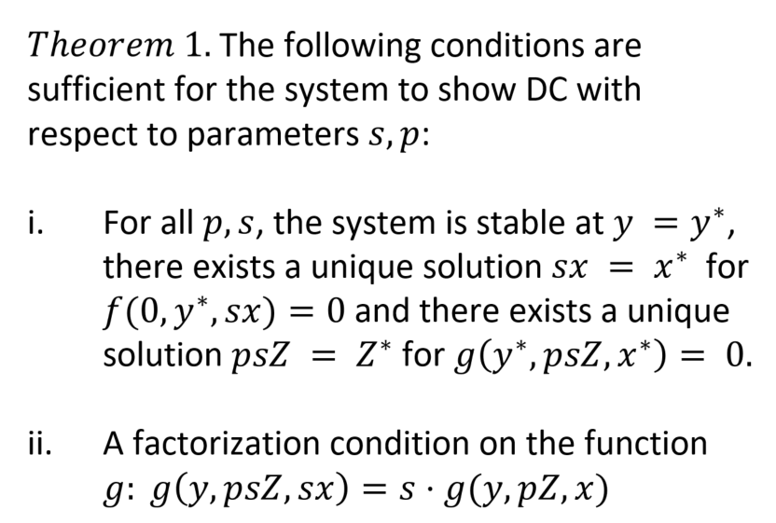
DC provides novel views on pathways to glucose homeostasis failure.
One of the conditions for DC is not met, condition (i) (stability at the desired set point).
DC is not robust to all of its parameters, only to certain ones.
DC in the model is affected by a mismatch between muscle and liver insulin resistance.

Slide 15
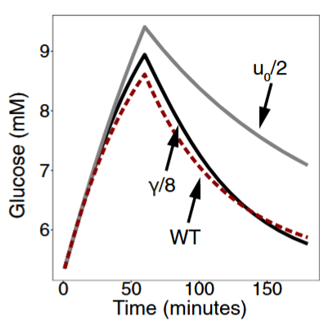
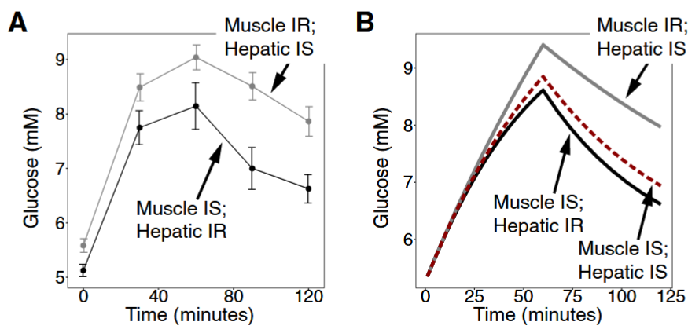
DC provides novel views on pathways to glucose homeostasis failure.
One of the conditions for DC is not met, condition (i) (stability at the desired set point).
DC is not robust to all of its parameters, only to certain ones.
DC in the model is affected by a mismatch between muscle and liver insulin resistance.

Slide 16
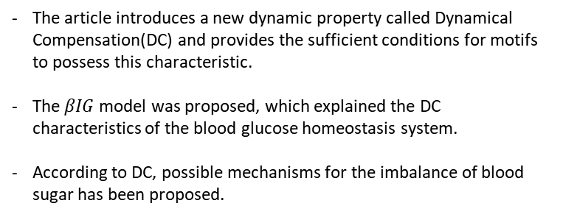
Brief Summary
The article introduces a new dynamic property called Dynamical Compensation(DC) and provides the sufficient conditions for motifs to possess this characteristic.
The $βIG$ model was proposed, which explained the DC characteristics of the blood glucose homeostasis system.
According to DC, possible mechanisms for the imbalance of blood sugar has been proposed.

Slide 17
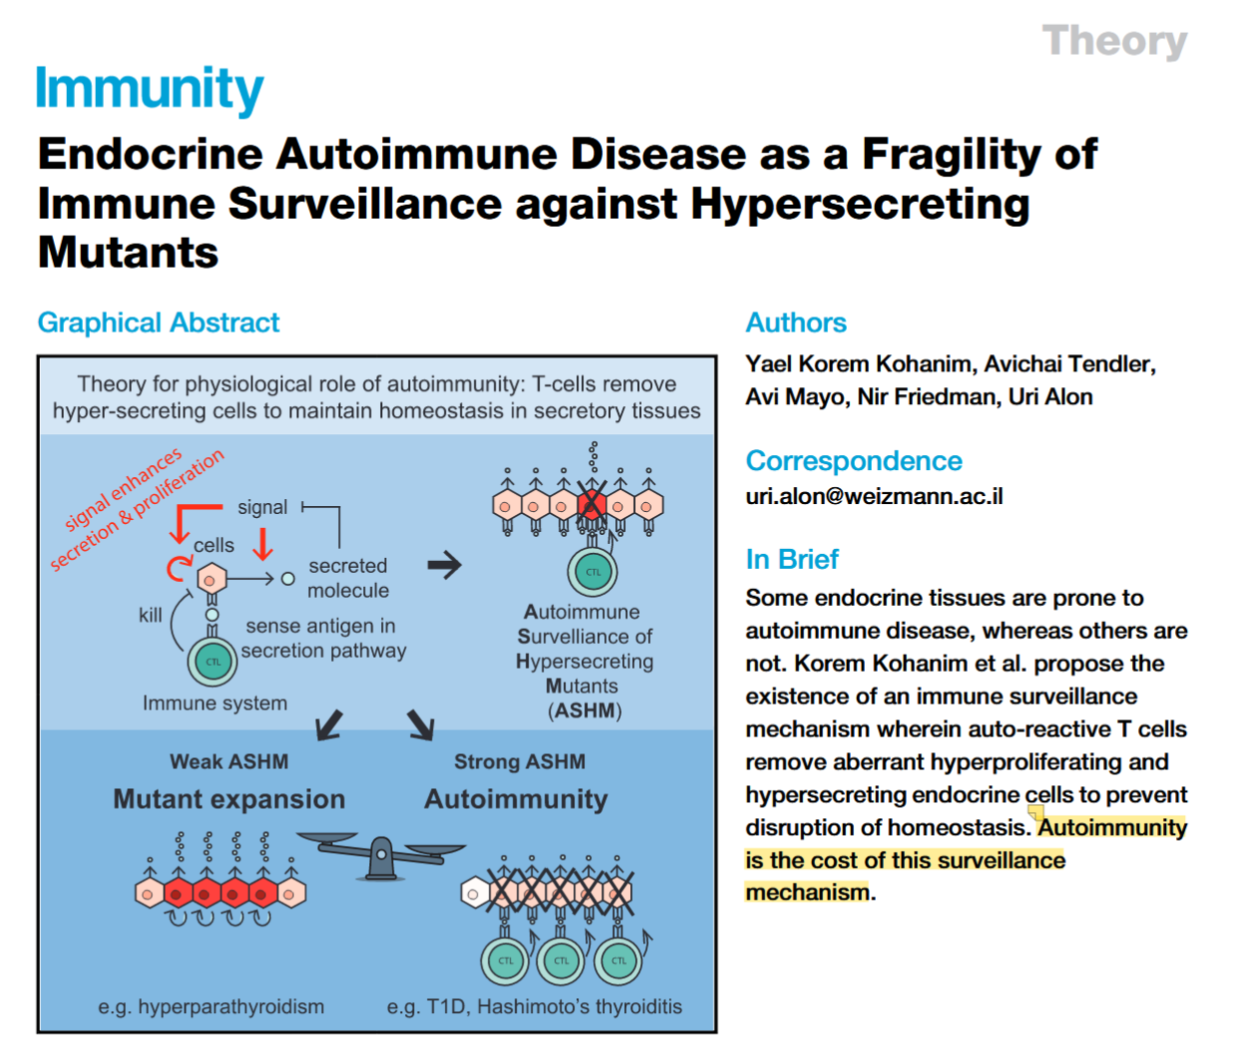
This article is mainly based on logical reasoning rather than mathematical models or experiments.
Autoimmunity is the cost of surveillance mechanism.

Slide 18
Observations and theories call for a reasonable explanation for autoimmune diseases.
Evolution point of view:
Observations:
The young age of onset and devastating nature of organ-specific autoimmune diseases carries a large evolutionary cost.
An essential biological process that would supply the healthy counterpart to autoimmune diseases.
Many organ-specific diseases occur in endocrine and exocrine organs.
Self-reactive T cells are found in healthy individuals.
Some endocrine organs are very rarely targets of autoimmunity.
“Nothing in Biology makes sense except in the light of evolution.”
——Theodosius Dobzhansky

Slide 19
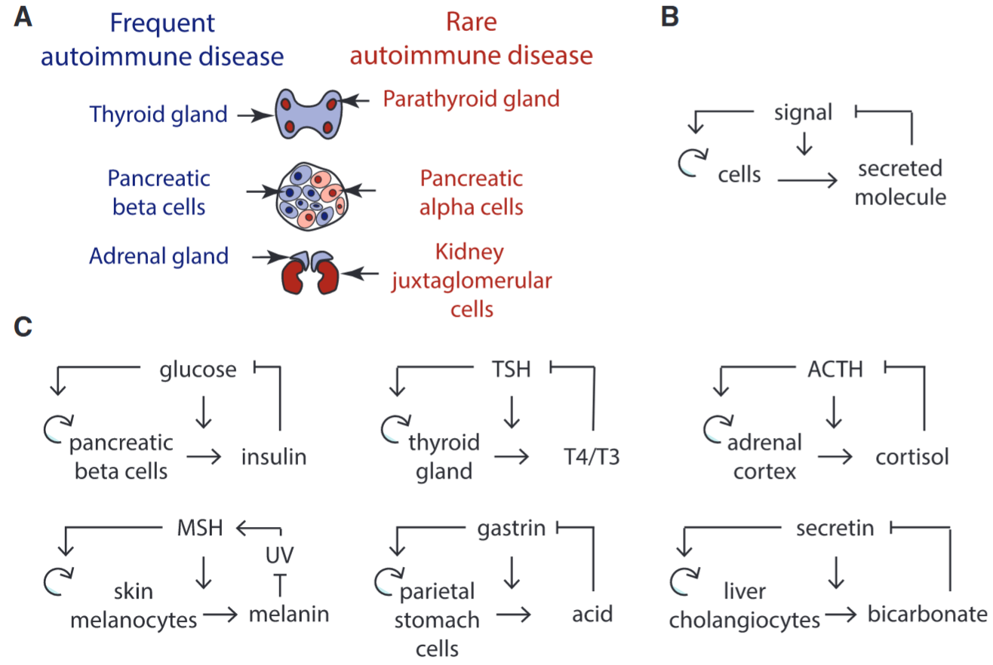
Secretory Organs Prone to Autoimmune Disease Share a Common Feedback Circuit Motif
DC is good, but at what cost?
In this circuit, mutant cells that hypersense the signal (dark red cells) have a larger growth rate and hypersecrete.

Slide 20
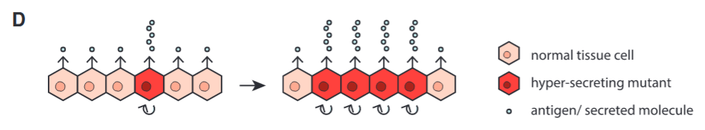
Secretory Organs Prone to Autoimmune Disease Share a Common Feedback Circuit Motif
DC is good, but at what cost?
In this circuit, mutant cells that hypersense the signal (dark red cells) have a larger growth rate and hypersecrete.
This would lead to such cells cloning expansion, resulting in hypersecretion.
There must be an controller.

Slide 21
Hypersensing mutations are not rare, thus non-negligible.
Thyroid: 10¹⁰ cells
The human mutation rate p = 10⁹/bp/division
any given mutation will arise about 10 times
At least 45 different activating mutations give rise to thyroid hypersecreting nodules
thyroid is expected to have hundreds of hypersecreting hyperproliferating nodules in every individual.

Slide 22
Autoimmune surveillance of hypersecreting mutants are proposed to explain the phenomena above.
Autoimmune Surveillance of Hypersecreting Mutants, ASHM
Controller
T cells would detect and remove cells with high expression of proteins in the secretion pathway relative to neighboring cells.
In this way, T cells targeting specific types of self-antigens restrict the growth of hypersecreting cells relative to other cells in the organ.
Mechanism
(i). Antigen target
(ii). Weak ASHM would show common hypercscreting expansion.
(iii). Such autoreactive T cells exist in healthy individuals.

Slide 23
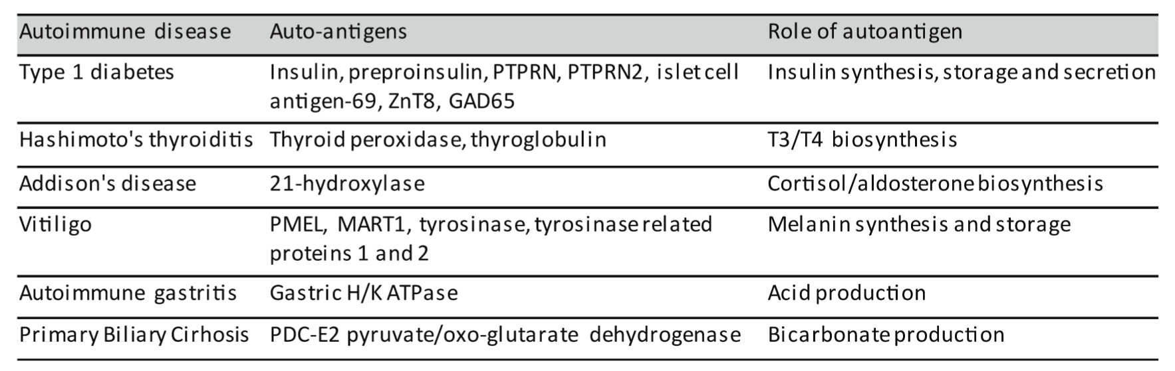
Antigen target at secreting pathway related moleculars.

Slide 24
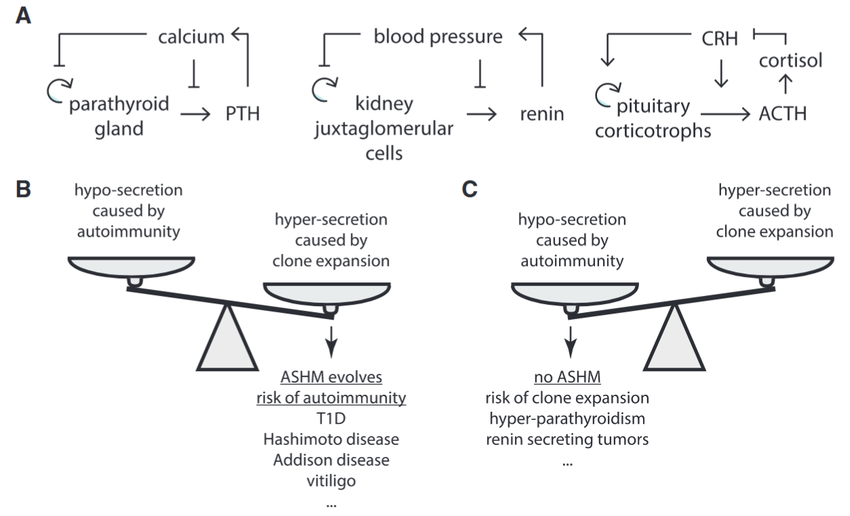
Endocrine Tissues that Rarely Exhibit Autoimmune Disease Are Prone to Mutant-Expansion Diseases.
Also DC, and fragile to hypersensing mutations
primary hyperparathyroidism: 1 of 50 postmenopausal women
Expansion common in the pituitary: about 20%
…

Slide 25
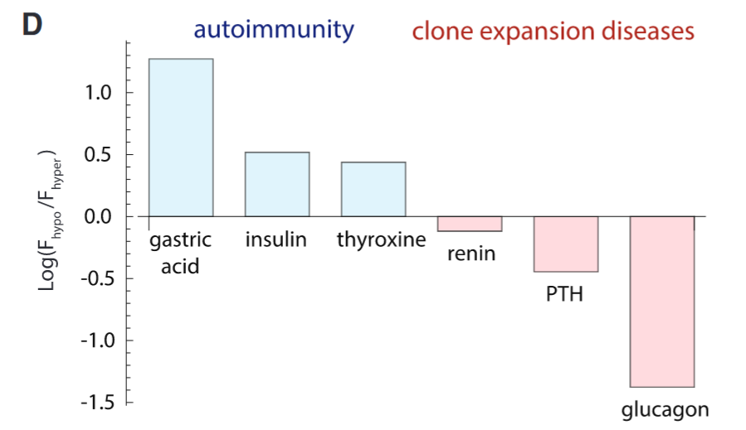
Endocrine Tissues that Rarely Exhibit Autoimmune Disease Are Prone to Mutant-Expansion Diseases.
Fitness Cost
if
hypersecretion > autoimmunity:
then
ASHM
else
Hypersecretion
end
F: the deviation from normal ranges in which lethality occurs.

Slide 26
T cells may be capable of differential killing according to autoantigen levels required for ASHM.
Found 30 perfect matches for TCRs from T1D, Hashimoto’s, and vitiligo mice in healthy mice.
Differential killing according to autoantigen levels requires moderate interaction.
TCR repertoire is adjusted for recognition selectivity.
hypersensitivity
?
Notes:
where a quantitative difference in protein expression of 2-to-3-fold would provide sufficient discrimination to achieve the postulated detection of hypersecretors.

Slide 27
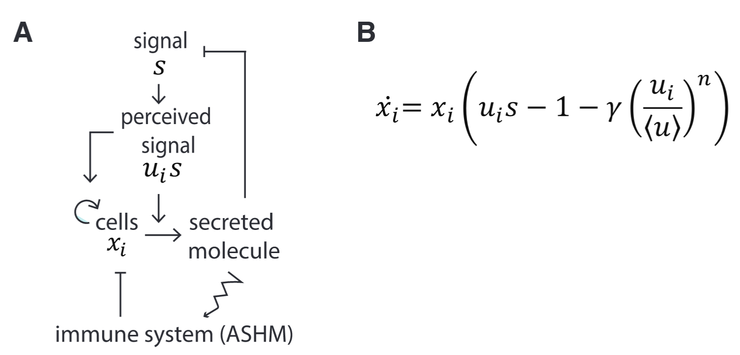
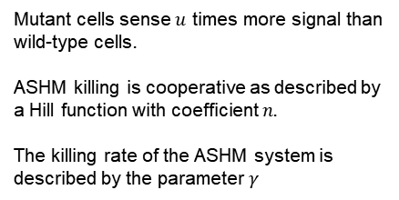
Mathematical Modeling Suggests that ASHM Can Eliminate Mutant Cells while Killing Few Normal Cells
Mutant cells sense $u$ times more signal than wild-type cells.
ASHM killing is cooperative as described by a Hill function with coefficient $n.$
The killing rate of the ASHM system is described by the parameter $γ$

Slide 28
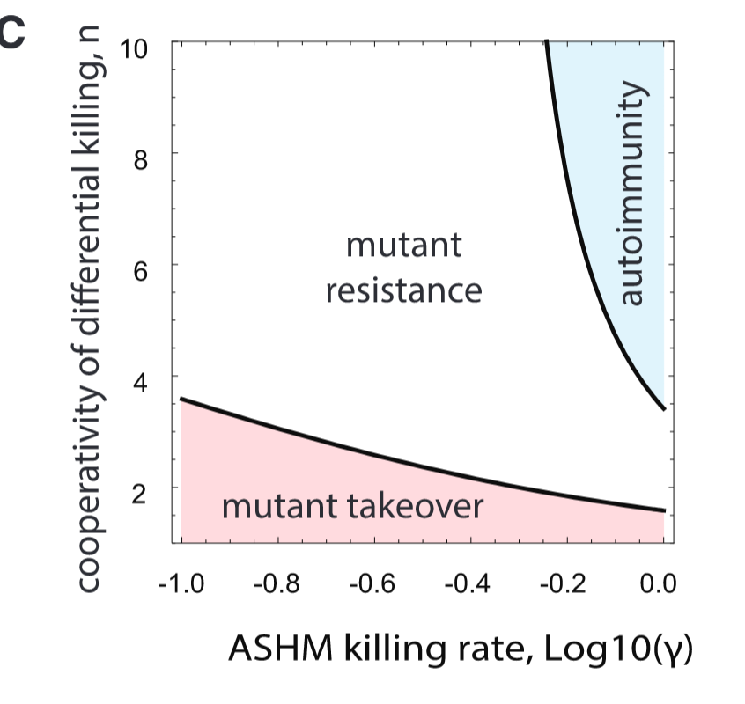
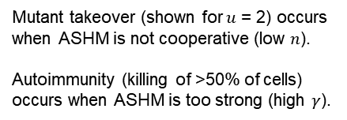
Mathematical Modeling Suggests that ASHM Can Eliminate Mutant Cells while Killing Few Normal Cells
Mutant takeover (shown for $u$ = 2) occurs when ASHM is not cooperative (low $n$).
Autoimmunity (killing of >50% of cells) occurs when ASHM is too strong (high $γ$).

Slide 29
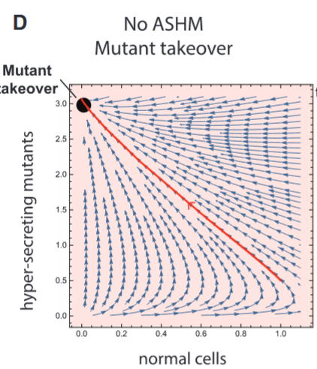
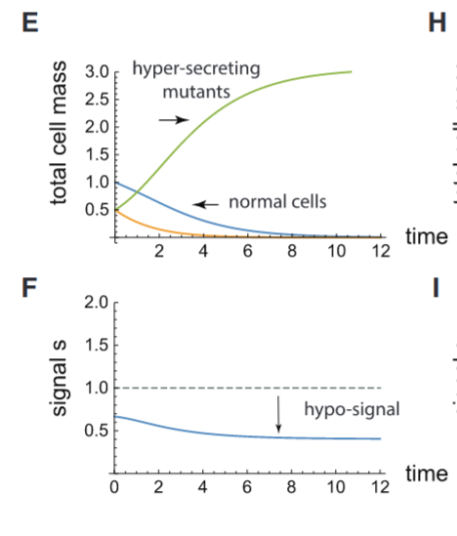
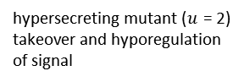
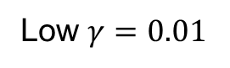
Mathematical Modeling Suggests that ASHM Can Eliminate Mutant Cells while Killing Few Normal Cells
Low $γ=0.01$
hypersecreting mutant ($u$ = 2) takeover and hyporegulation of signal

Slide 30
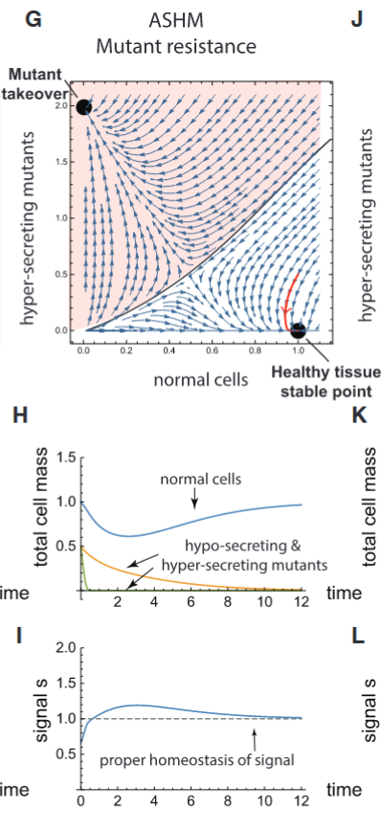
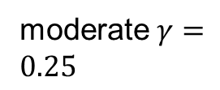
Mathematical Modeling Suggests that ASHM Can Eliminate Mutant Cells while Killing Few Normal Cells
moderate $γ=0.25$
mutant elimination and normal regulation unless mutant population is large

Slide 31
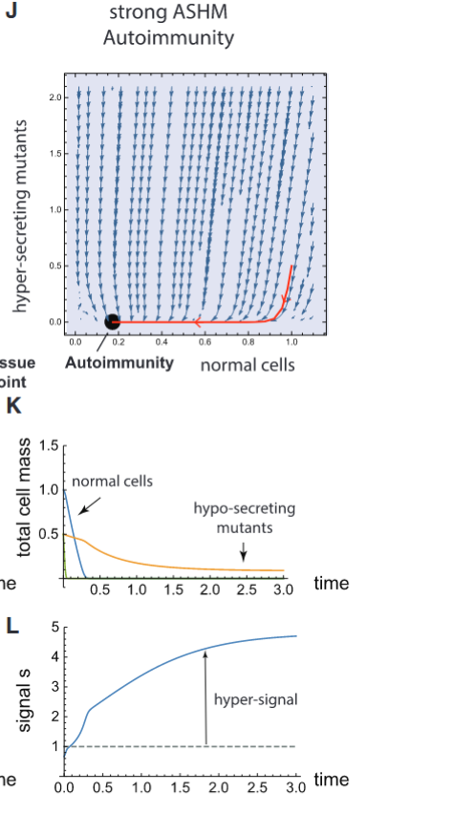

Mathematical Modeling Suggests that ASHM Can Eliminate Mutant Cells while Killing Few Normal Cells
high $γ=0.25$
loss of tissue and hyperregulation of signal

Slide 32
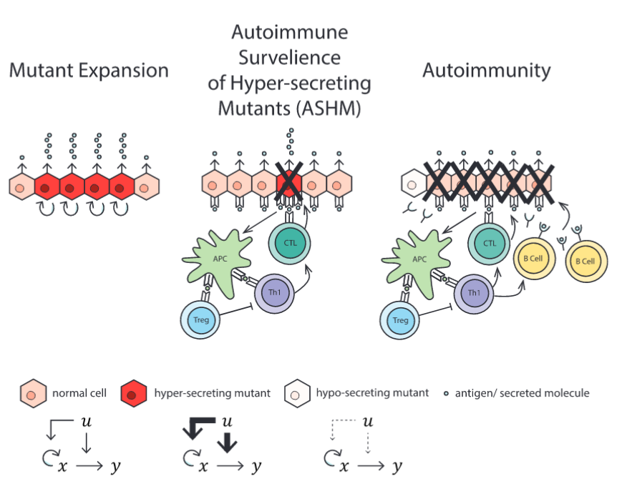
Summary

